Slide 1

Name Surname
Date: dd/mm/yyyy
McKinsey Consulting
Report Slides

Slide 2




Company A
Company B
Company C
Company A has a significant presence in the sector, with a market share of 35%, compared to 20% for [Competitor B] and 12% for [Competitor C].
Company B has a presence in the sector with a market share of 20%, compared to 35% for [Competitor A] and 12% for [Competitor C].
Company C has a presence in the sector with a market share of 12%, compared to 35% for [Competitor A] and 20% for [Competitor B].

Slide 3
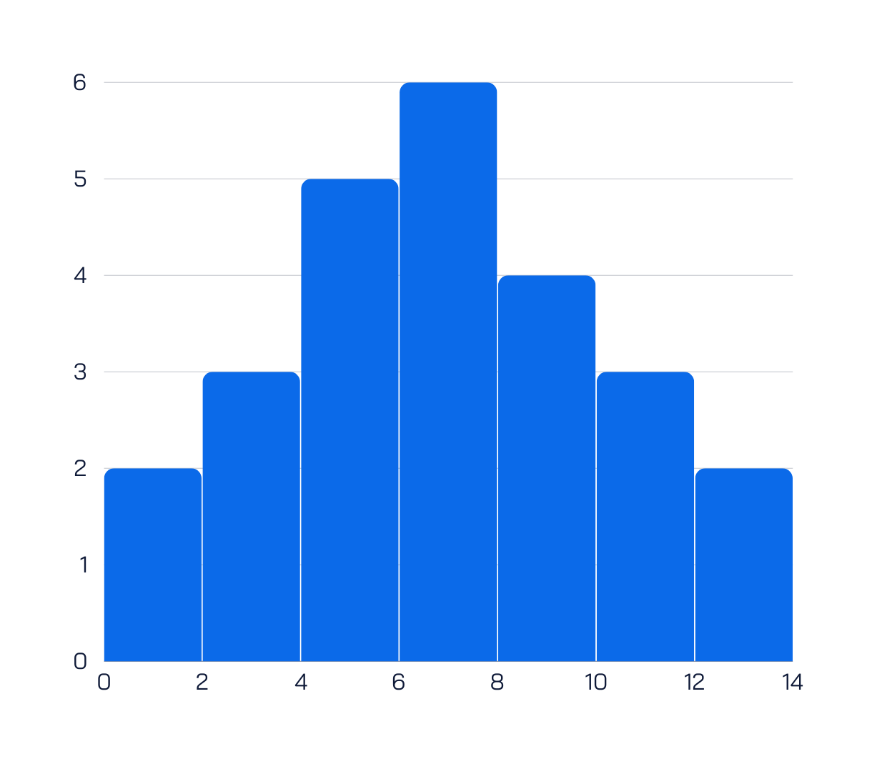
Executive Summary
quis proident Lorem incididunt nostrud nulla anim occaecat nisi in cillum exercitation nulla ullamco mollit irure ipsum laborum consectetur aute minim pariatur anim culpa ipsum ut qui et non consequat et dolor labore nostrud exercitation occaecat anim voluptate voluptate officia ullamco fugiat velit dolore fugiat sunt pariatur ut esse aute aliquip enim magna aute quis sint non enim officia aute do pariatur deserunt officia in
quis proident Lorem incididunt nostrud nulla anim occaecat nisi in cillum exercitation nulla ullamco mollit irure ipsum laborum consectetur aute minim pariatur anim culpa ipsum ut qui et non consequat

Slide 4



2000
2005
Briefly elaborate on what you want to discuss.
Briefly elaborate on what you want to discuss.
2010
Briefly elaborate on what you want to discuss.

Slide 5


2015
2020
Briefly elaborate on what you want to discuss.
Briefly elaborate on what you want to discuss.
2030
2025
Briefly elaborate on what you want to discuss.
Briefly elaborate on what you want to discuss.

Slide 6

1
Add a main point
3
Add a main point
Briefly elaborate on what you want to discuss.
Briefly elaborate on what you want to discuss.
2
Add a main point
4
Add a main point
Briefly elaborate on what you want to discuss.
Briefly elaborate on what you want to discuss.

Slide 7
THANK YOU

